Slide 1

Security in Cloud Computing

Slide 2
Introduction
Cloud computing has lots of unique properties that make it very valuable.
Unfortunately, many of those properties make security a singular concern.
Many of the tools and techniques that users would use to protect its data, comply with regulations, and maintain the integrity of their systems are complicated by the fact that users are sharing their systems with others and many times outsourcing their operations as well.

Slide 3
Introduction
Cloud computing service providers are well aware of these concerns and have developed new technologies to address them.
Different types of cloud computing service models provide different levels of security services.
Risks in any cloud deployment are dependent upon the particular cloud service model chosen and the type of cloud on which the user deploy their applications.
Logging, auditing, and regulatory compliance are all features that require planning in cloud computing systems.
They are among the services that need to be negotiated in Service Level Agreements.

Slide 4
Introduction
When the user identifies missing security elements in the cloud, they can use that mapping to work to close the gap.
Adapting on-premises systems to a cloud model requires that the users determine what security mechanisms are required and mapping those to controls that exist in the chosen cloud service provider.
Storing data in the cloud is of particular concern.
Data should be transferred and stored in an encrypted format.
The user can use proxy and brokerage services to separate clients from direct access to shared cloud storage.

Slide 5
Choosing Cloud??
Determine which resources (data, services, or applications) user is planning to move to the cloud.
Determine the sensitivity of the resource to risk
Determine the risk associated with the particular cloud type for a resource.
Taking into account the particular cloud service model that you will be using.
If the user have selected a particular cloud service provider, they need to evaluate its system to understand how data is transferred, where it is stored, and how to move data both in and out of the cloud

Slide 6
Areas for security concerns in cloud computing
There are numerous security issues for cloud computing as it encompasses many technologies.
With each technology, the specific security measures has to be taken and are applicable to cloud computing.
There are six specific areas of the cloud computing environment where equipment and software require substantial security attention

Slide 7
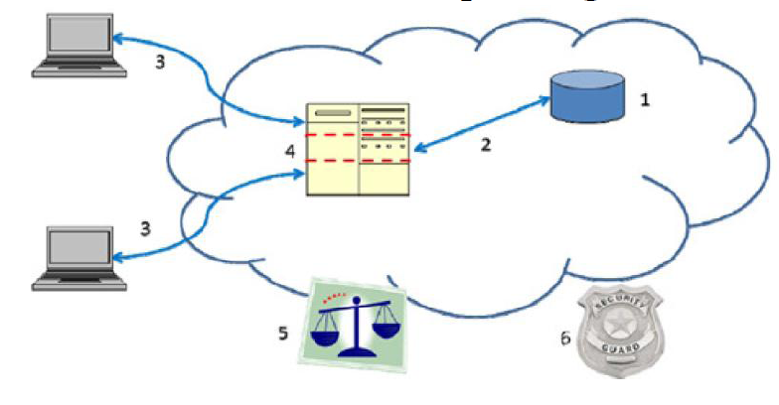
Areas for security concerns in cloud computing

Slide 8
Areas for security concerns in cloud computing
These six areas are:
(1) Security of data at rest
(2) Security of data in transit
(3) Authentication of users/applications/ processes
(4) Robust separation between data belonging to different customers
(5) Cloud legal and regulatory issues
(6) Incident response

Slide 9
Areas for security concerns in cloud computing
For securing data at rest
Cryptographic encryption mechanisms are certainly the best options
For securing data in transit
Encryption
Authentication
Integrity protection mechanisms
Authentication
User authentication
Access control

Slide 10
Areas for security concerns in cloud computing
Separation between a cloud provider’s users
Virtual machines and hypervisor
Trusted platform module
Legal and regulatory issues
Each customer must have its legal and regulatory experts
Incident response
An automated response
Automated notification

Slide 11
Security concerns in Traditional IT
Threat vectors are not new to cloud, but have somewhat different dynamics
In classic IT architecture, PCs inside the organization may be at risk of compromise through a
– Host of attack vectors exploiting local applications such as browses or documents viewers.
–The attacker could compromise credentials to gain access.
– A compromise to an entire Gmail database probably began with a compromised PC

Slide 12
Security concerns in Traditional IT
– Shared authentication tokens can lead to brittle defenses.
–Organizations must be careful to safeguard data as they move it around their organization
– When data is no longer need, it must be properly deleted, or else risk leaking sensitive data to the outside
–Similarly, all organizations are vulnerable to an insider attack from a trusted insider
–A unified data system with more people accessing more different types of data through more applications can actually make it harder to appropriately limit access and detect misuse

Slide 13
Security Issues in Cloud Computing
Security in the cloud is achieved, through third party controls and assurance
But since there is no common cloud computing security standard, there are additional challenges associated with this.
Any cloud vendors implement their own proprietary standards and security technologies, and implement differing security models, which need to be evaluated on their own merits.
In a vendor cloud model, it is ultimately down to adopting customer organizations to ensure that security in the cloud meets their own security polices through requirements gathering provider risk assessments, due diligence, and assurance activities.

Slide 14
Security Issues in Cloud Computing
The security challenges faced by organizations wishing to use cloud services are not radically different from those dependent on their own in-house managed enterprises.
•The same internal and external threats are present and require risk mitigation or risk acceptance

Slide 15
Cloud Security Threats
The threats to information assets residing in the cloud can vary according to the cloud delivery models used by cloud user organizations
There are several types of security threats to which cloud computing is vulnerable.
The threats for cloud customers are categorized according to the confidentiality, integrity and availability (CIA) security model and their relevance to each of the cloud service delivery model.

Slide 16
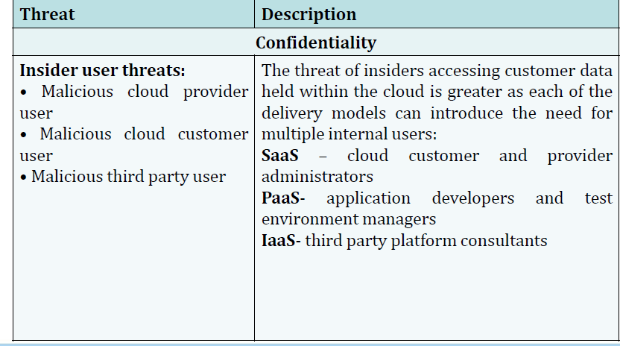
Cloud Security Threats

Slide 17
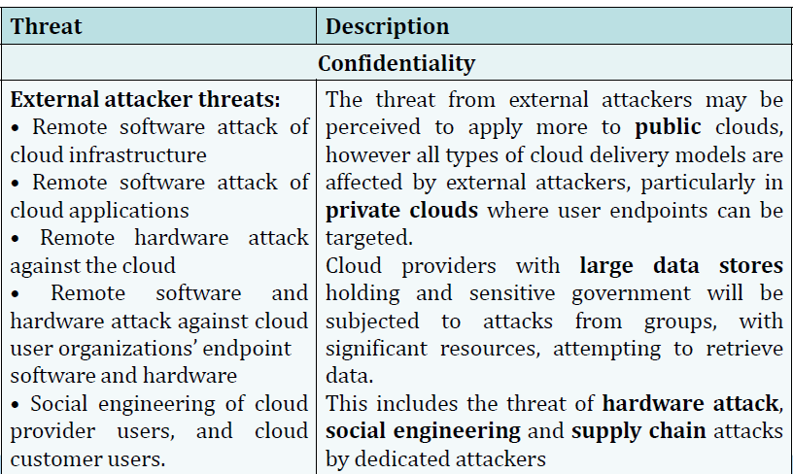
Cloud Security Threats

Slide 18
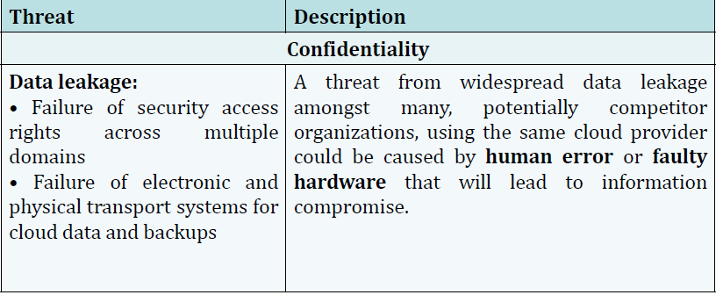
Cloud Security Threats

Slide 19
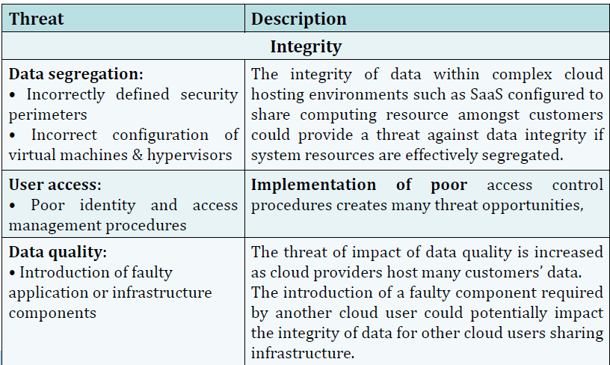
Cloud Security Threats

Slide 20
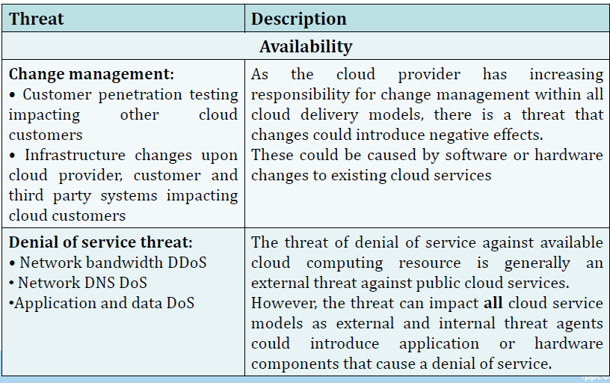
Cloud Security Threats

Slide 21
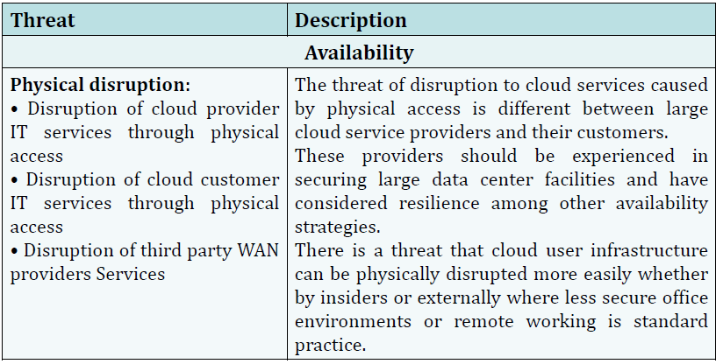
Cloud Security Threats

Slide 22
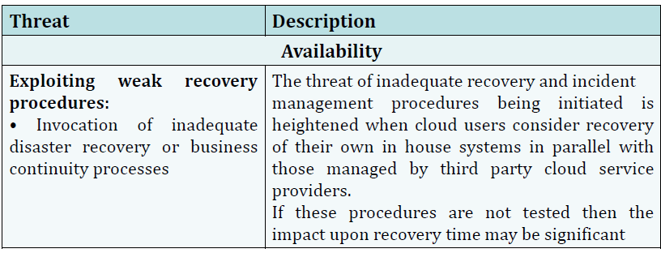
Cloud Security Threats

Slide 23
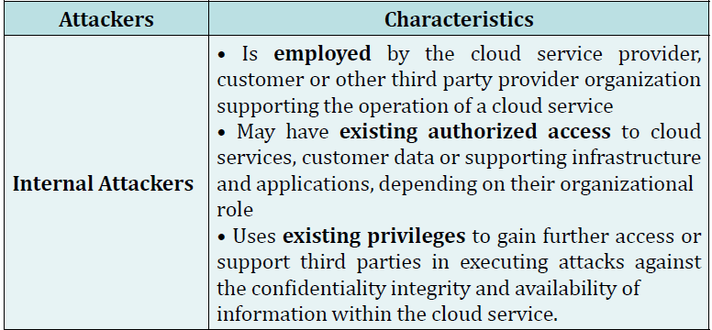
Types of Attackers in Cloud Computing

Slide 24
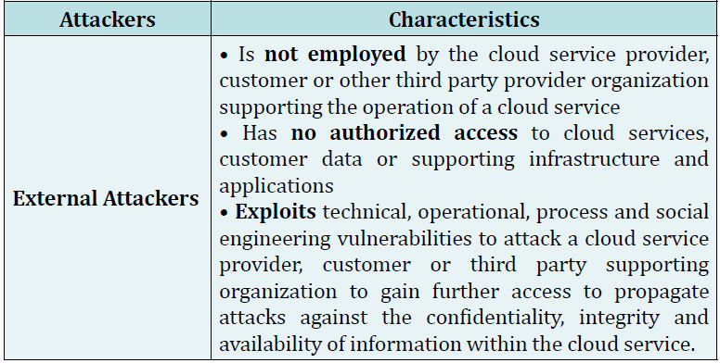
Types of Attackers in Cloud Computing

Slide 25
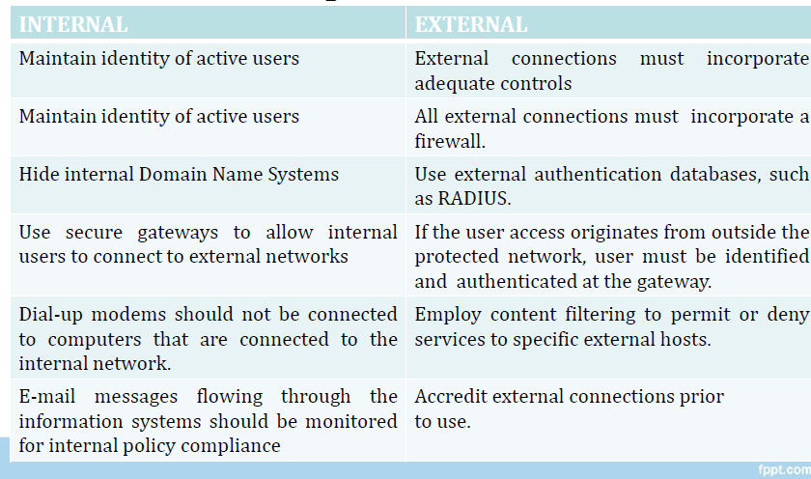
Types of Attackers in Cloud Computing

Slide 26
Types of Attackers in Cloud Computing
Attackers | Characteristics
Random | The most common type of attacker uses simple tools and techniques. The attacker may randomly scan the Internet trying to find vulnerable components. They will deploy well known tools or techniques that should be easily detected
Weak | Semi-skilled attackers targeting specific servers/cloud providers by customizing existing publicly available tools or specific targets. Their methods are more advanced as they attempt to customize their attacks using available exploit tools

Slide 27
Types of Attackers in Cloud Computing
Attackers | Characteristics
Strong | Organized, well-financed and skilled groups of attackers with an internal hierarchy specializing in targeting particular applications and users of the cloud. Generally this group will be an organized crime group specializing in large scale attacks.
Substantial | Motivated, strong attackers not easily detected by the organizations they attack, or even by the relevant law enforcement and investigative organizations specializing in eCrime or cyber security. Mitigating this threat requires greater intelligence on attacks and specialist resources in response to detection of an incident or threat

Slide 28
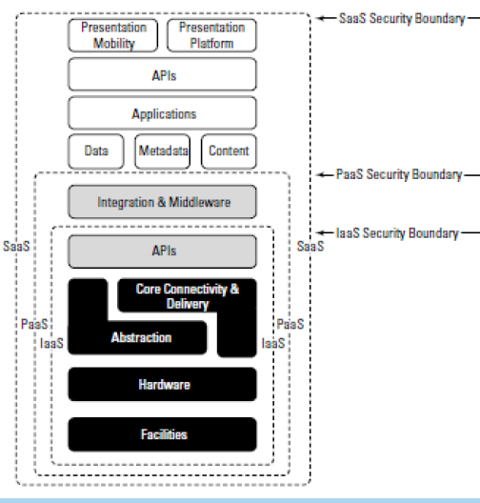
Security Service Boundary
As user ascend the stack, IaaS has the least levels of integrated functionality and the lowest levels of integrated security, and SaaS has the most.

Slide 29
Security Service Boundary
Each different type of cloud service delivery model creates a security boundary at which the cloud service provider’s responsibilities end and the customer’s responsibilities begin.
Any security mechanism below the security boundary must be built into the system, and any security mechanism above must be maintained by the customer.
As user move up the stack, it becomes more important to make sure that the type and level of security is part of their your SLA

Slide 30
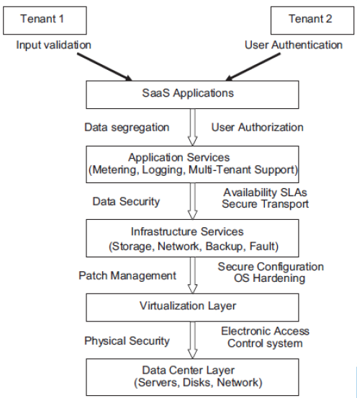
Security issues in SaaS
The following key security elements should be carefully considered as an integral part of the SaaS application development and deployment process:
–Data security
–Network security
–Data locality
–Data integrity
–Data segregation
–Data access
– Authentication and authorization

Slide 31
Security issues in PaaS
In PaaS, the provider might give some.
But any security below the application level such as host and network intrusion prevention will control to the people to build applications on top of the platformstill be in the scope of the provider and the provider has to offer strong assurances that the data remains inaccessible between applications.
For the PaaS model, the security boundary may be defined for the vendor to include the software framework and middleware layer.

Slide 32
Security issues in IaaS
With IaaS the developer has better control over the security as long as there is no security hole in the virtualization manager.
The security responsibilities of both the provider and the consumer greatly differ between cloud service models.
IaaS is prone to various degrees of security issues based on the cloud deployment model through which it is being delivered

Slide 33
Abuse and Nefarious Use of Cloud Computing

Slide 34
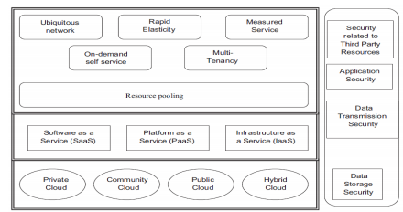
Complexity of security in a cloud environment

Slide 35
Abuse and Nefarious Use of Cloud Computing
Abuse and nefarious use of cloud computing is considered as the top security threat to cloud computing because cloud providers do not enforce any strong registration process where any person with a valid credit card can register to receive cloud services; this huge flaw in the registration system coupled with weak fraud detection capabilities lends cloud computing models such as IaaS and PaaS to malicious attacks by criminals who can leverage those technologies and target cloud providers.

Slide 36
Abuse and Nefarious Use of Cloud Computing
Attacks relating to “abuse and nefarious use of cloud computing” threat:
Host Hopping Attacks
Malicious Insider and Abuse of Privileges.
Identity Theft Attacks
Service Engine Attacks

Slide 37
Host Hopping Attacks
This attack exploits one of the most defining characteristics of cloud computing: resource sharing
This attack can be launched by hackers if cloud provider does not enforce strict mechanism to isolate shared resources such as memory, storage, and reputation of different customers or hosts.
Failing to separate tenants (customers) can certainly facilitate this type of attack and thereby allow malicious hackers to hop on other hosts to compromise other customers’ data and gain illegal access to it.
This attack can be particularly dangerous for public clouds and the PaaS model where multiple clients share the same physical machine.
Attackers can cause severe damage that could range from compromising sensitive customer data to interrupting service for cloud providers and distorting their image and reputation

Slide 38
Malicious Insider and Abuse of Privileges
The shared and multi-tenancy nature of cloud computing creates a fertile ground for insider threat and promotes risk of “privilege abuse” to confidential customer information.
Hosting sensitive information from multiple clients on the same physical machine certainly entices users with high privilege roles such as system administrators and information security managers to abuse their privileged access to clients’ sensitive data and the possibility of leaking or selling that information to competitors or other parties of interest.
The possibility, and hence impact, of this risk can be further amplified if cloud provider does not enforce strict definition of roles and responsibilities or does not apply the “need to know” principle

Slide 39
Identity Theft Attacks
Malicious hackers can easily set up accounts with cloud providers to use cloud resources by simply paying for the usage without any restrictions or limits from cloud vendors on resource consumption or workloads.
Attackers can exploit this advantage to use and compromise customer’s critical information and sell it for a price.
Furthermore; cyber criminals could also set up rogue clouds and entice individuals to host their sensitive data and provide cloud computing services such as e-mail applications.
Once individuals entrust their confidential data with rogue cloud providers, their identity is at risk and can be compromised and thereby can lead to identity theft and financial fraud.

Slide 40
Service Engine Attacks
The service engine is a highly customized platform that sits above the physical layer and characterizes the underlying cloud architecture; this service engine is normally controlled by cloud provider to mange customer resources but it can be rented by potential customers who wish to use and adopt the IaaS model.
Hackers can abuse this feature by subscribing to the IaaS model and renting a virtual machine that would be hosted and controlled by the service engine; then they can use the VM to hack the service engine from the inside and use the service engine to their advantage where it may contain sensitive business information through other VMs from other cloud subscribers.
In other words, hackers can escape the isolation feature that separates data belonging to different cloud customers and possibly breach and compromise their confidential data

Slide 41
Service Hijacking
Cloud account hijacking is a process in which an individual or organization's cloud account is stolen or hijacked by an attacker.
Account hijacking occurs when a criminal obtains your personal data information and uses it to take over your accounts
Cloud account hijacking is a common tactic in identity theft schemes in which the attacker uses the stolen account information to conduct malicious or unauthorized activity.

Slide 42
Service Hijacking
Remediation
Prohibit the sharing of account credentials between users and services.
Leverage strong two-factor authentication techniques where possible.
Employ proactive monitoring to detect unauthorized activity.
Understand cloud provider security policies and SLAs

Slide 43
Data Leakage
The unauthorized transfer of classified information from a computer or datacenter to the outside world.
A cloud leak is when sensitive business data stored in a private cloud instance is accidentally exposed to the internet
Data leakage can be accomplished by simply mentally remembering what was seen, by physical removal of tapes, disks and reports or by subtle means such as data hiding.

Slide 44
Data Leakage
Reasons for Data leakage:
Weak Passwords.
Theft of a Company Item From Employee.
Exploiting Vulnerabilities.
Accidentally Emailing Sensitive Information or Publishing It Online.
Malicious Attacks That Result in Data Leakage.
Phishing

Slide 45
Data Leakage
Remediation
Implement strong API access control.
Encrypt and protect integrity of data in transit.
Analyzes data protection at both design and run time.
Implement strong key generation, storage and management, and destruction practices.

